Slide 1
How To: Create a Webex Meeting
By Ben Fortner & Erica Tillman

Slide 2
Webex for USM
Webex for the University:
usm.webex.com
As pictured below

Slide 3
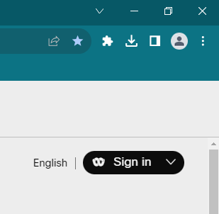
Signing in:
Use the “sign in” button on the Webex Landing Page

Slide 4
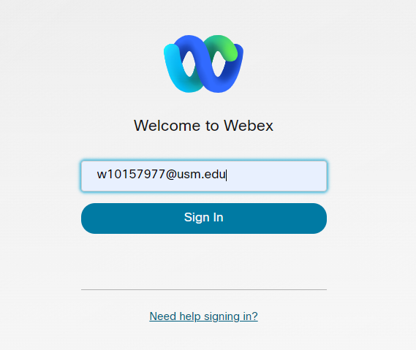
Signing in:
If prompted, sign in with your USM credentials
(@usm.edu)

Slide 5
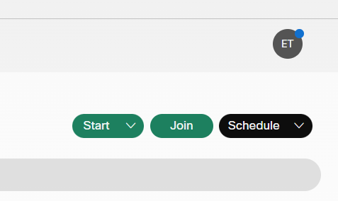
Scheduling a Meeting:
To schedule a meeting, click on “Schedule” as pictured above

Slide 6
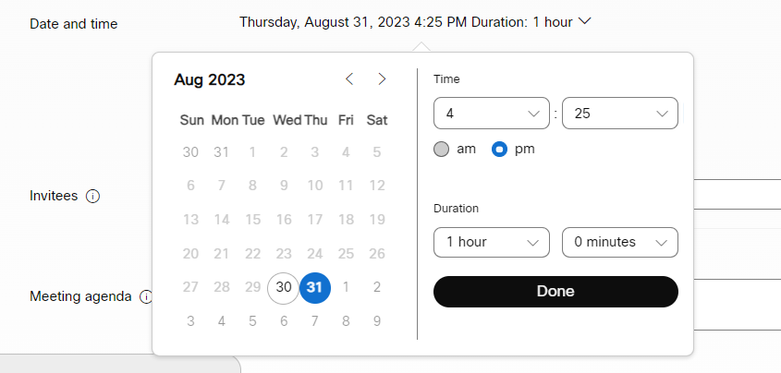
Non-Recurring Meetings:

Slide 7
One Time or Recurring?
A One-time Meeting is for when you are only hosting one meeting. This will give you and your attendees a one-time notification of the meeting schedule.
A Recurring Meeting will repeat within your given set of parameters.
This will send an email reminder to each attendee on the dates the meeting is scheduled to take place.
All join information for recurring meeting will remain the same throughout the duration of the meeting series.

Slide 8
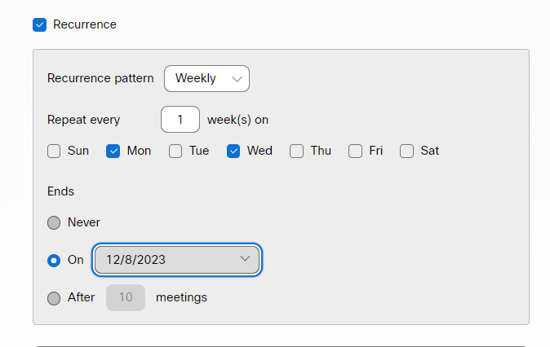
Recurring Meetings:
Note: Recurrence pattern can be set to
Daily
Weekly
Monthly
Yearly
After checking the recurrence box:
Select the day(s) your class will meet
and the end date for your course

Slide 9
Adding Invitees:
You may add your invitees using:
Email
W Number @usm.edu

Slide 10
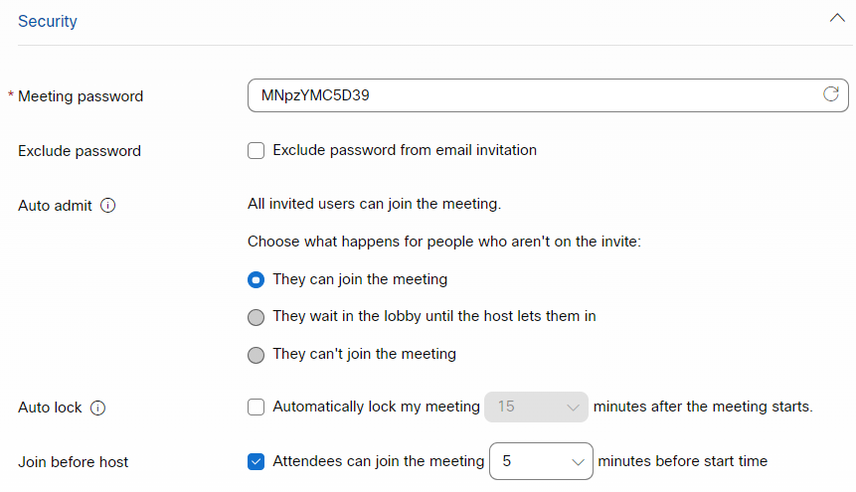
Security Options:
Here, you may choose what happens when attendees join your meeting

Slide 11
Advanced Options:
In “Advanced Options” you may choose “Automatic recording”
Automatic recording will save a recording of your meetings, and save them to your “recordings” tab in Webex, and you can export however you choose.
You may also record meeting on a case-by-case basis, using the “record” feature during your meeting

Slide 12
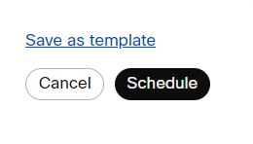
Schedule Your Meeting:
You’re almost done!

Slide 13
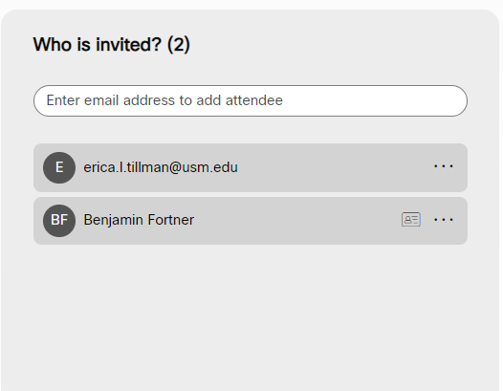
Sending Invites:
After clicking “Schedule”:
Your Meeting info will be displayed to you as well as sent out to your invitees.
You can add others later if you need to.

Slide 14
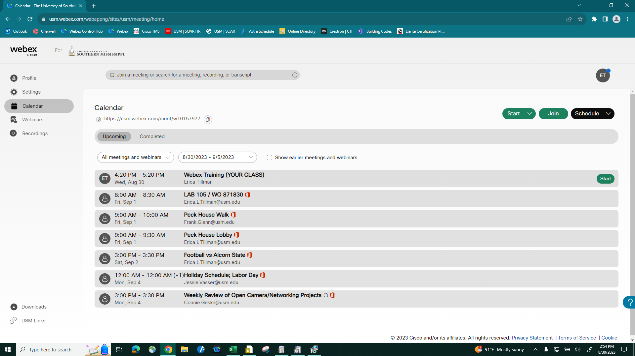
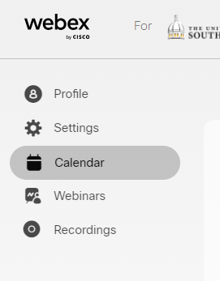
Your Meeting Calendar:
Your Calendar tab will:
Show your scheduled meetings.
Allow you to make changes.
Allow you to join or start a meeting.

Slide 15
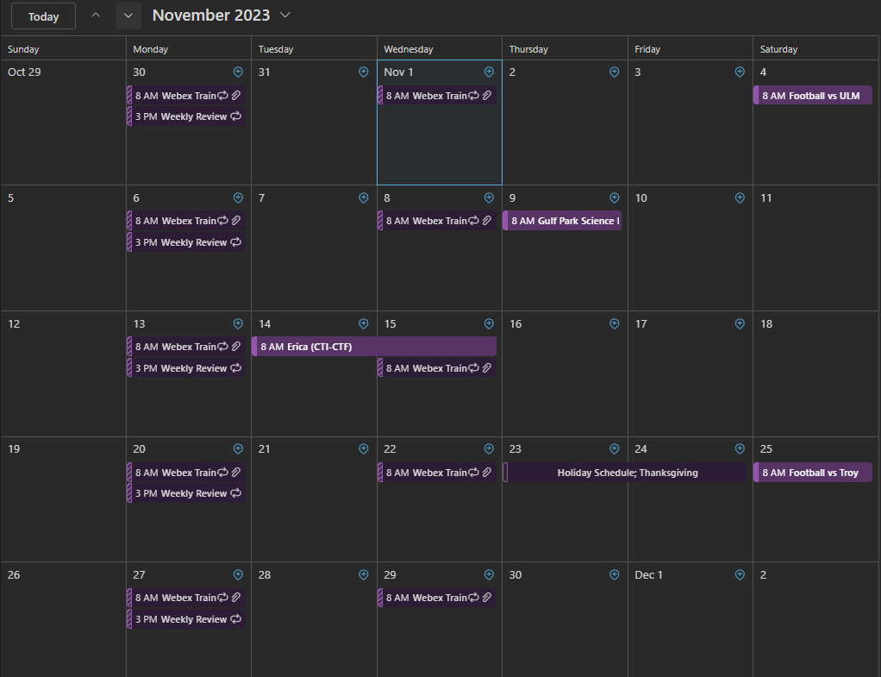
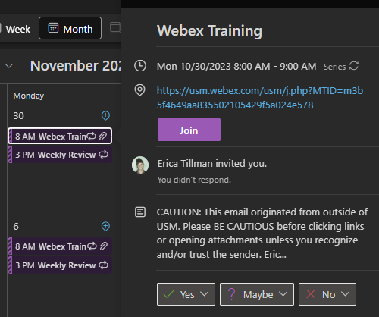
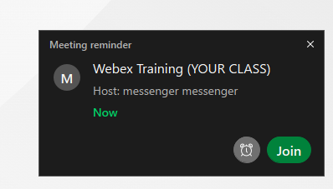
Ways to Start a Meeting:
In addition to starting your Meeting in Webex, you can also begin from:
Your email
Your Outlook reminder
Or even your Outlook Calendar

Slide 16
THANK YOU
Continuing education is a major part of academia, and we want you to succeed!
For Help by Phone:
Hattiesburg: 601-266-4364
Gulf Coast: 228-214-3235
For Help in Person:
You may place a work order through the iTech Website
-or-
Call 601-266-HELP
More information is available on the Webex Page

